Slide 1
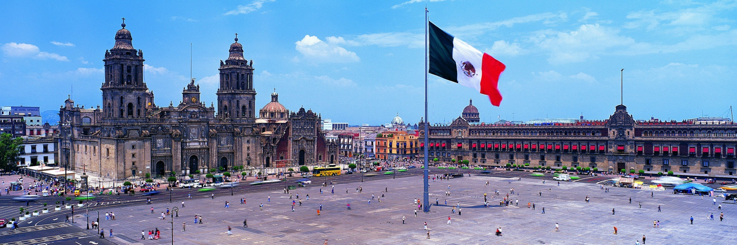
MEXICO
From: Thiago Chamorro - 6º Grado «A»

Slide 2
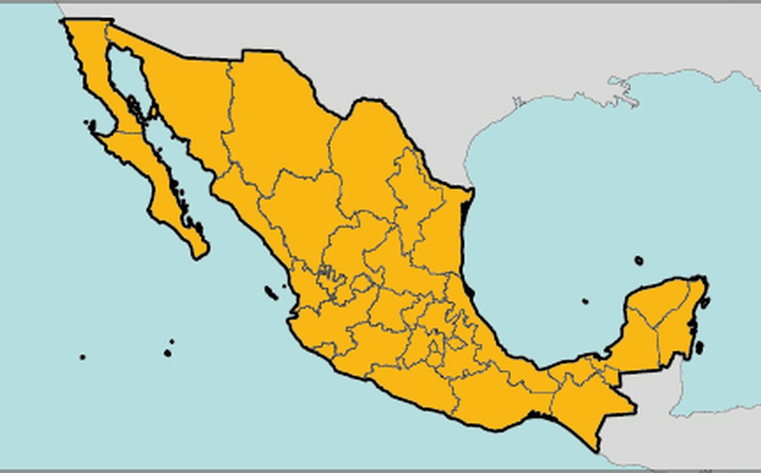
CONTINENT AND CAPITAL CITY
Mexico is on the North American Continent
The Capital City of Mexico is Mexico City

Slide 3
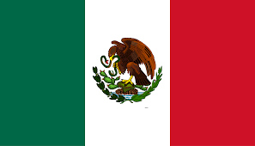
OFFICIAL LANGUAGE, INDEPENDENCE YEAR AND COLOURS OF THE FLAG
The official language is Spanish
The Independence year: 1821
The colours of the flag: Left: green, Middle: white and Right: red

Slide 4
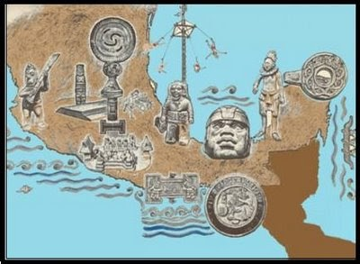
Currency, Important Landmarks and Ancient civilizations
Currency: Mexican Peso
Important Landmarks: Construction of the pyramid of the sun in Teotihuacan. Foundation of Tenochtitlan. Mexican Revolution.
Ancient Civilizations: Aztecs, Mayans, Toltecs

Slide 5
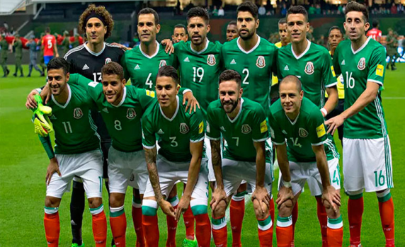
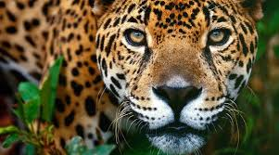
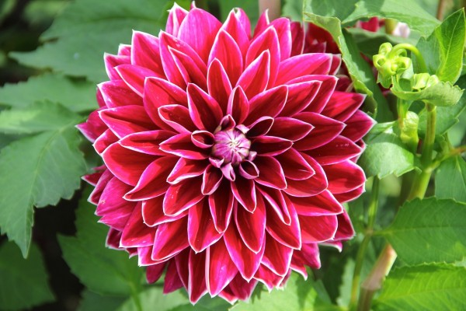
National Sports, National animal and National flower
National Sports: Soccer
National Animal: Jaguar
National Flower: Dahlia

Slide 6
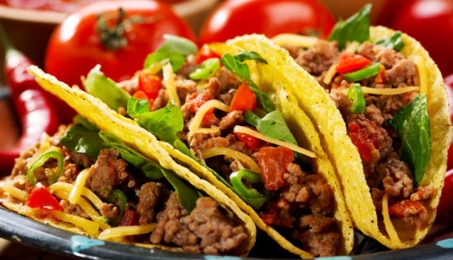
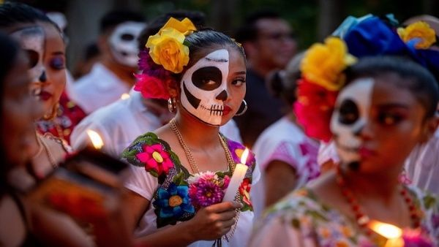
Popular Food and Important day / Festival
Popular Food: Tacos, Burritos, Churros and empanadas
Important day / Festival: Day of the Dead. Day of the virgin of Guadalupe.

Slide 7
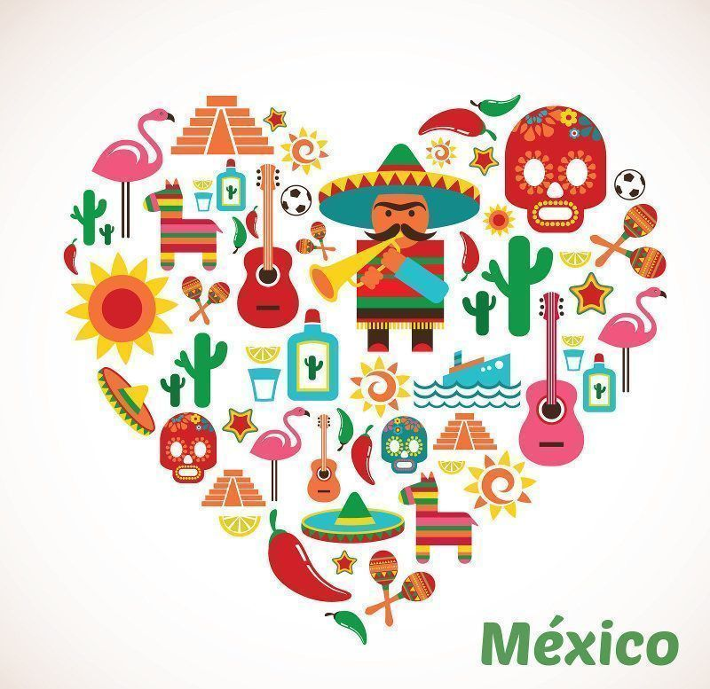
Why did you choose Mexico?
I chose Mexico because I like its landscape, its culture and its customs.

